Slide 1
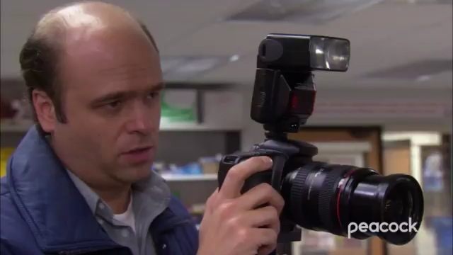
CSE 5330-003
CAB BOOKING SERVICE
Team 10
AARTI SANDEEP AGRAWAL
MANSI R PATEL
SAKSHI SHAILENDRA KSHIRSAGAR
VAISHNAVI VIJAY KALAL

Slide 2
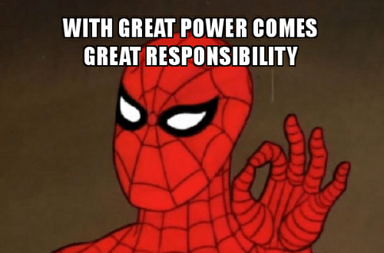
WHAT INSPIRED US TO CHOOSE THIS PROJECT?
As students, especially international students, buying a car is not the best financially viable option. And even if it is, buying a car comes with its own set of responsibilities.
And with all things we already have on our plates, we can do better without adding more to them.
And that how cab services come to our rescue!

Slide 3
PROJECT OVERVIEW
Details About our Project
Personal details of Customer
Details About Customer Pass (if holds)
Personal details of Driver
Details of Vehicle
Details about Locations
Details about each Bookings

Slide 4
HOW WILL THIS PROJECT BE HELPFUL IF DEPLOYED IN THE REAL WORLD?
Flexible travel plan
Freedom of choosing pick up and drop locations
Safe options to travel for customers
Suitable cabs that falls within your budget
Varying cab size according to the number of passengers

Slide 5
TABLES DETAILS
No of Tables : 9
Fall22_S003_10_Customer
Customer ID, Name, DOB, Account Creation Date
Fall22_S003_10_Customer_Ph_no
Customer ID, Phone Number(s)
Fall22_S003_10_Driver
License No, Name, DOB, Phone Number
Fall22_S003_10_Vehicle
Vehicle ID, Category of Vehicle, License No
Categories : SUV, Sedan, Compact, SUV Premium, Sedan Premium, Compact Premium

Slide 6
Fall22_S003_10_Pass
Pass ID, Customer Id, Pass Start Date, Pass End Date
Fall22_S003_10_Location
Zip Code, Type of Location
Type of Locations: University, Commercial, Residential, Industrial
Fall22_S003_10_Goes_From
Zip code, Vehicle ID
Fall22_S003_10_Goes_To
Zip code, Vehicle ID
Fall22_S003_10_Books_Details
Customer Id, Vehicle ID, Booking Date, Start Time, End Time, Pick up Location , Drop Location, Price

Slide 7
PROJECT OVERVIEW CONTI…
Rows per Table:
Fall22_S003_10_Customer : 50
Fall22_S003_10_Customer_Ph_no : 70
Fall22_S003_10_Driver : 40
Fall22_S003_10_Vehicle : 40
Fall22_S003_10_Pass : 40
Fall22_S003_10_Location : 40
Fall22_S003_10_Goes_From : 50
Fall22_S003_10_Goes_To : 50
Fall22_S003_10_Books_Details : 50
Total Rows: 430

Slide 8
PROJECT GOAL
Did you meet all your business goals?
Yes, we were able to meet all our business goals
Discuss the need and result of your most interesting business goal
One of the most interesting business goals in our project is retrieving the list of zip codes which fall under the type of location having the most popular pickup zip code.
Result: The most popular zip code is: 0024 , which falls under the “Residential” location type. List of zip codes falling under this particular location type are: 0021,0022,0023,0024,0025,etc…

Slide 9


HOW DID WE MANAGE THE TASKS AND TIME?
Working randomly on the project and ending up messing everything without any results
Dividing tasks amongst team members
and working in coordination to get the
best possible results in required time

Slide 10
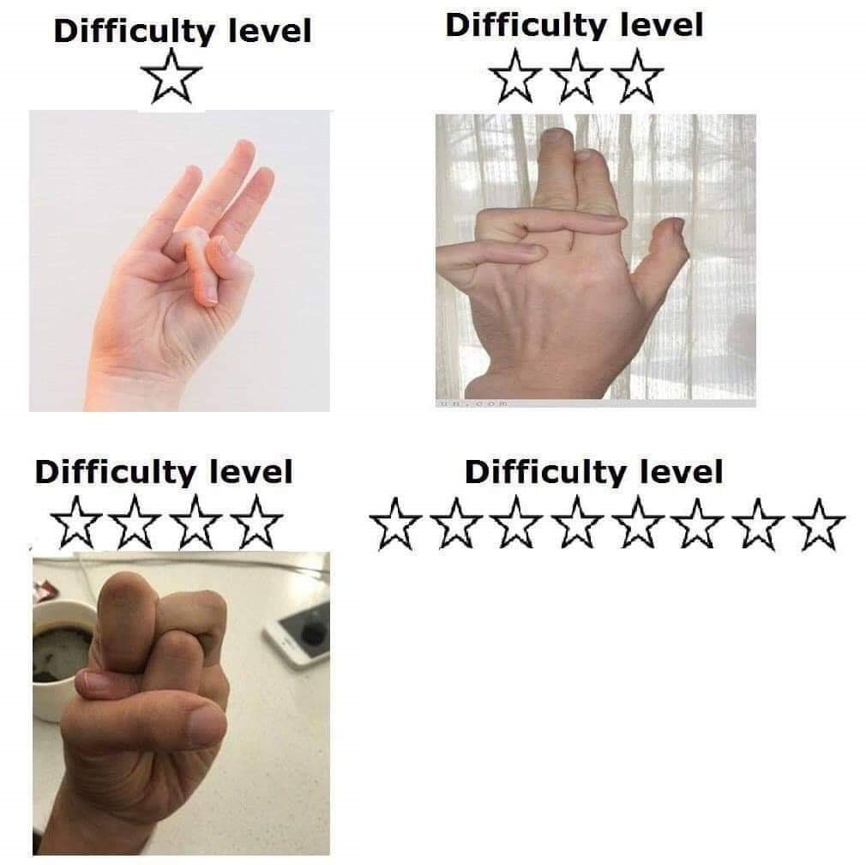
MOST CHALLENGING PHASE?
PHASE
4

Slide 11
CHANGE IN APPROACH IF GIVEN THE CHANCE TO REDO PROJECT
Having gotten familiarized with the different phases of the project, if given a chance to redo the project, we would:
Invest more time researching and understanding about the business in depth.
We would try and get some real-time data which will help us extract information can help the client in the real-world scenario.

Slide 12
PROJECT TAKEAWAY
Are you happy with what you have developed? Yes, we are happy with what we have accomplished and how this project can advance.
Do you think this will add strength to your resume? Yes, because it demonstrates a solid database foundation and has given us insight and practical experience into how real-world initiatives operate behind the scenes.
What was your takeaway from the project that you think may help you in future? The entire process of database creation and maintenance and how it can be processed to produce the necessary output will unquestionably aid us to manage the real-life projects we'll be working on in the future.

Slide 13
OVERALL FEEDBACK
How can the project experience be improved? The initial part can include a presentation where students can communicate, share ideas, and offer each other advice on how to make their idea better while also including new features.
How can the course experience be improved? We don't believe any adjustments are necessary as the course curriculum covers all necessary core concepts of databases.
How can the test experience be improved? Students can learn how to answer a particular query by taking separate practice test.

Slide 14

GENERAL
Any general feedback or thought that you want to share?
It was a fun learning experience, doing the practical implementation of the theoretical concepts learned in the class.
Working in a team helped in learning about different perspectives and ideas while tackling a problem at hand.

Slide 15


Slide 16
Discussion

